Slide 1

ONLINE GAMING INDUSTRY
Names:-Tharun (192110195)
Saketh (192111737)
Subject :- Principles Of Management
Subject Code :-UBA3366

Slide 2
Abstract :
The gaming industry in India is on a roll. Traditional games are gradually being replaced by video games, which has a direct effect on how internet users spend their free time . The availability of platform and game distribution systems is a key factor in the explosion in online gaming interest. The rising popularity of online games has given birth to a new industry. In recent years, the gaming industry, which includes innovative professionals, has risen to prominence .The gaming industry is expanding as per capita income grows, interest rises, and the number of dual-income household rises, all of which are contributing to the market. The market is expected to expand rapidly in the future, thanks to increased use of smartphones and consoles, as well as cloud penetration. Also, because of the recent COVID-19 outbreak, the industry is seeing rapid growth in terms of users and games downloaded. This research paper focuses on the subject of the evolution and growth of the gaming industry in India by identifying, characterizing and addressing the changes that have led to the development of gaming industry in India.

Slide 3
Objectives:
Altogether, playing online games help players develop complex problem- .
To prepare students to work in teams. to prepare students to improve their skills and knowledge related to specific job positions individually.
To develop creativity and individuality in problem solving and performing tasks. To enable students to do self-study.
Online gaming is one of the widely used leisure activities by many people. For some people it is said that playing video games has a number of reasons to be played.
For it can be a stress reliever, challenge and competition, relaxation, enjoyment, social interaction, and even mentally escaping from the real world.

Slide 4
Introduction:
The gaming industry is no longer a niche arena for a certain age group or consumer segment. With the advent of mobile gaming and improvements to hardware used in playing these games, gaming has become a viable form of entertainment for players from all backgrounds and ages. This switch to mainstream has also meant an increase in revenues generated by the industry with about US $9.5 billion generated in the United States in 2007, 11.7 billion on 2008 and 25.1 billion in 2010.
The improvements to hardware such as sound cards, graphics and faster processors have meant a related growth and development of the gaming industry as well. As a result, modern games, especially those that are PC based, have become very demanding as applications and serious gamers are among those who purchase high-powered personal computers to keep up with the newest games.

Slide 5
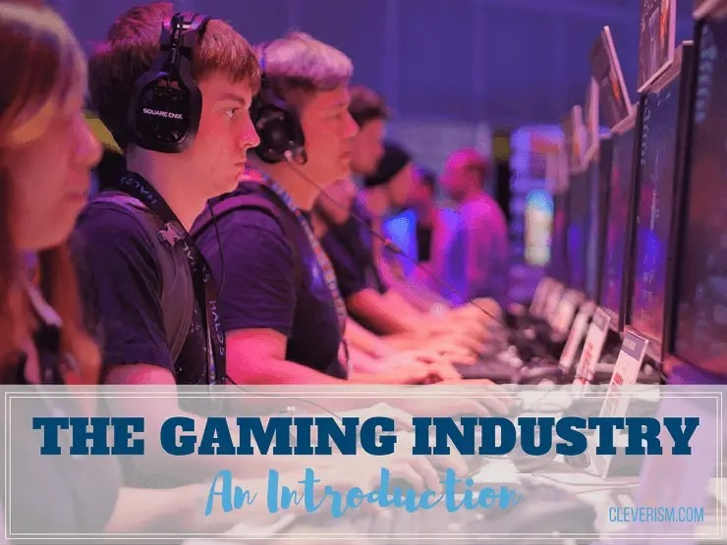
History Of Gaming Industry :
The gaming industry has undergone a substantial evolution since the 1970s and has moved from a fringe activity into the mainstream. In 1971, the arcade game Computer Space was released and was followed up by Atari Inc’s first commercially successful video game, Pong. Games entered the home formally with the release of an early gaming console called the Magnavox Odyssey. The market lost momentum in 1977 and was rejuvenated in 1978 by another successful game called Space invaders. With this, arcade machines began to appear in mainstream public spaces such as malls, stores and restaurants. Space invaders went on to make $2 billion in 1982. In the late 1970s, personal computer gaming also took off and the development of computing led to a simultaneous advancement in gaming technology as well

Slide 6
Literature Survey: MMORPG :-
In the year of 2003, “Rag Online”, on of MMORPG licensed from Gravity Corporation, South Korea. It was localized into Thai language to serve Thai gamers. “This game was an immense success, with the highest peak Concurrent Users of over 110,600”. 2012, chap. 41; Hoe et al., 2011; Lo & Wen, 2010; Rezaei , 2014).
MMORPGs are form of MUD games that offer a persistent 3D virtual world to support thousands of players to playing together on the Internet or PCs (Lo & Wen, 2010). “In an MMORPG, the world exists before the user logs on, and continues to exist when the user logs off” (Yee, 2006).
MMORPGs brought a significant role in online game player interactions within game industries.

Slide 7
Zee(2003) and Young (2005) also mentioned :
Excessive mental effort on internet
Spending hours even though being intended to spend couple of minutes
Exposure to health problems due to spending hours in front of the screen each time
Continuously waiting for the next connection time
Feeling more comfortable contacting people over internet than talking face-to-face
Decrease in meals, lessons or work efficiency due to using internet or staying connecting
Trying to give or spread the mail address, chat room names etc to everybody

Slide 8

International Journal of Science and Research :
According to the report, between Q2 2014 and Q2 2016, game downloads in India more than doubled, with Google Play generating 13 times more downloads compared to iOS. In Q2 2016, over 300 million games were downloaded on iOS and Google Play combined in India. “The volume growth is a positive step towards the development of the Indian gaming industry. I am very bullish about the growth in the Indian mobile gaming industry. With the expansion of smartphones in the country, the number of downloads will further rise,” says Deepak Ail, Co-Founder and CEO of Interactive, who has been in the gaming industry for the past 18 years.

Slide 9
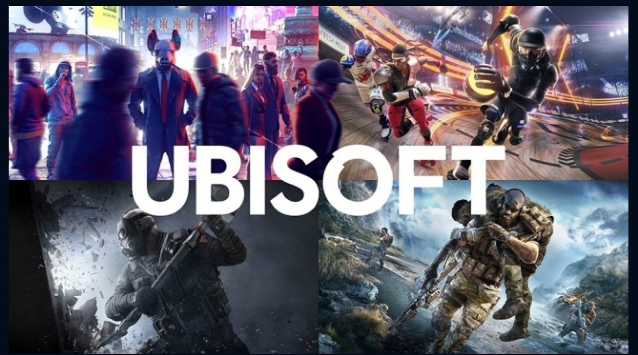

TOP ONLINE GAMING INDUSTRY IN WORLD :

Slide 10
Advantages:
It helps reduce stress. Physical Health Issue.
Insomnia.
Lack of concentration.
Poor Academic performance.
Lead to social isolation.
Disadvantages:
It elevates one’s mood.
It enhances the development of social skills.
It improves concentration.
It provides a source of income.

Slide 11
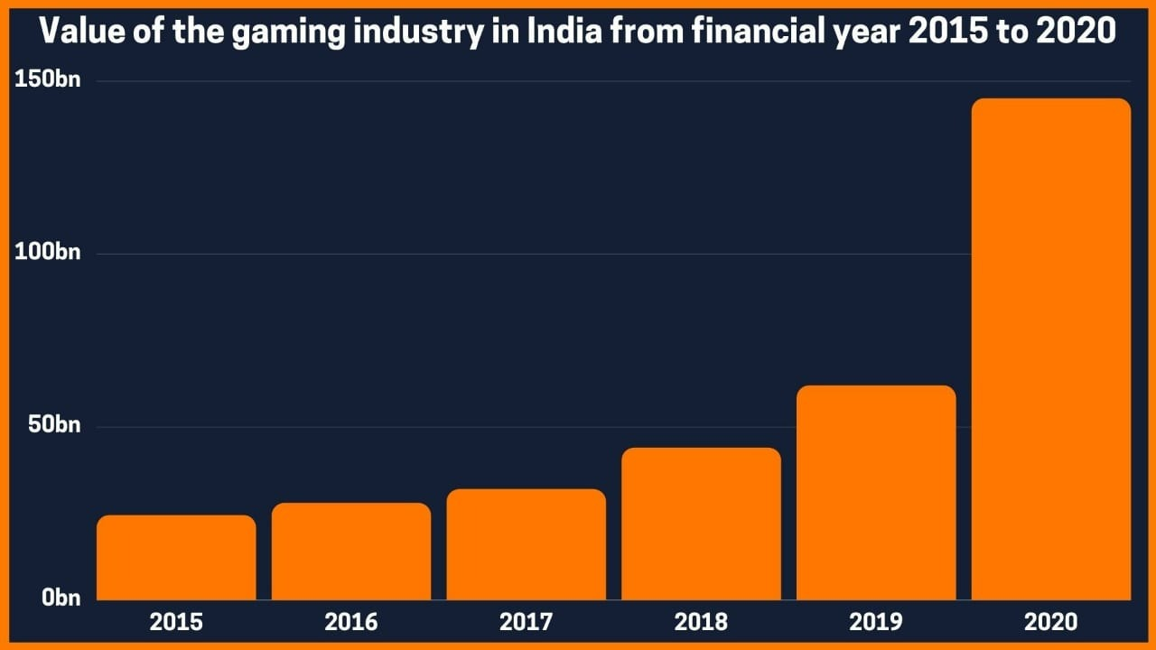
Research Methadalogy:
Descriptive associational research method has been used for this study. The aim of the descriptive perspective is to determine related cases. This type of research is used to demonstrate associations and relations between two and more variables (KASHMIR, 2009).
The Population and Sample of the Study:
The population of this research involves all high school students in North Cyprus. The sample for the research consists of 61.8 % (n=81) female, 38.2 % (n=50) male, total 131 high school students. The sample was selected through criterion sampling method of the purposive sampling. Students who had their own personal computers were set as a criteria.

Slide 12
Findings:
For the google survey the total number of responses we
get is 40.
It is about the development of online gaming industry from past years.
The responses we got on type of games you like :-
Action-adventure :- 59%
Simulation :- 7.1%
Multi-player :- 28.9%
Strategic :- 5.1%
The opinion on online games :-
It gives entertainment :- 71.1%
It reduces stress :- 28.9%

Slide 13

Data Analytics:
It is about the online gaming industry development and people’s response on the online gaming. The responses are recorded from the google forms.
There are mainly four types of games :
1.Action-adventure
2.Simulation
3.Multi-player
4.Strategic

Slide 14
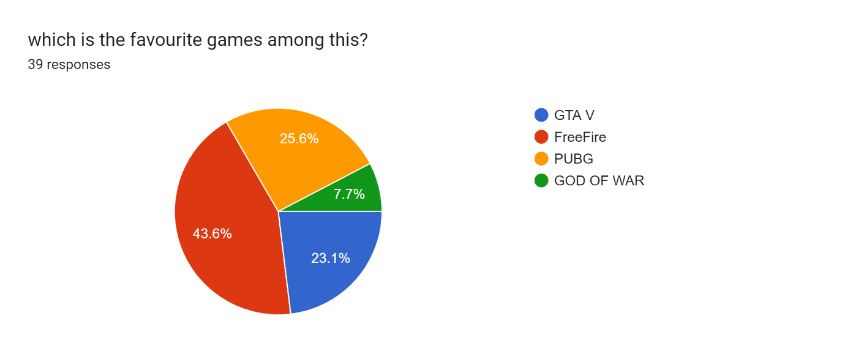
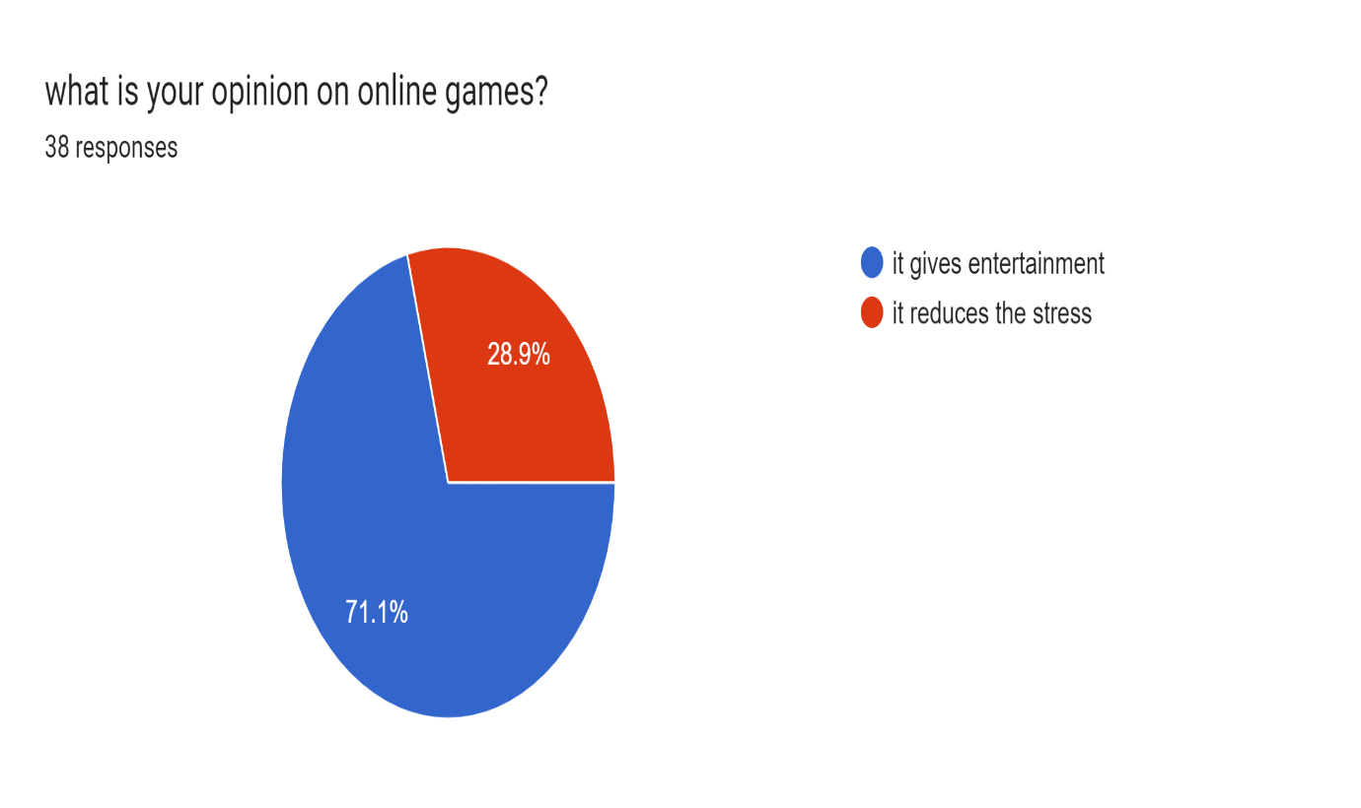
Responses :

Slide 15
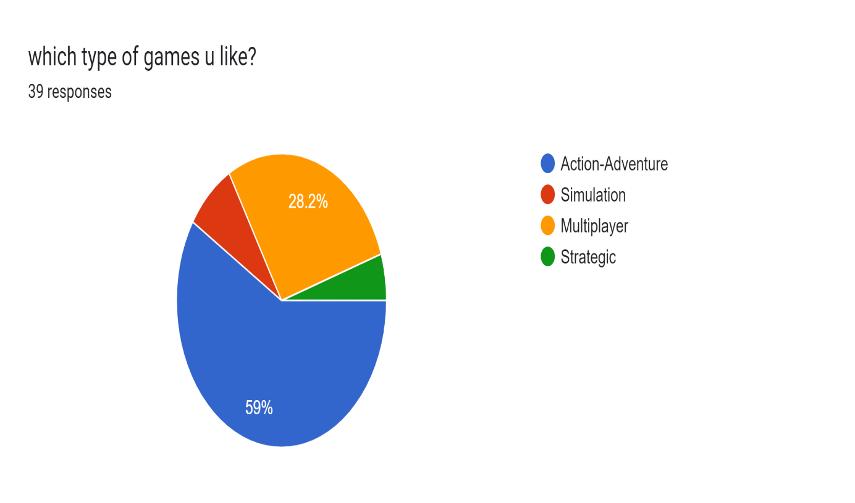
On the basis of the google form survey the games which u like the most :-

Slide 16
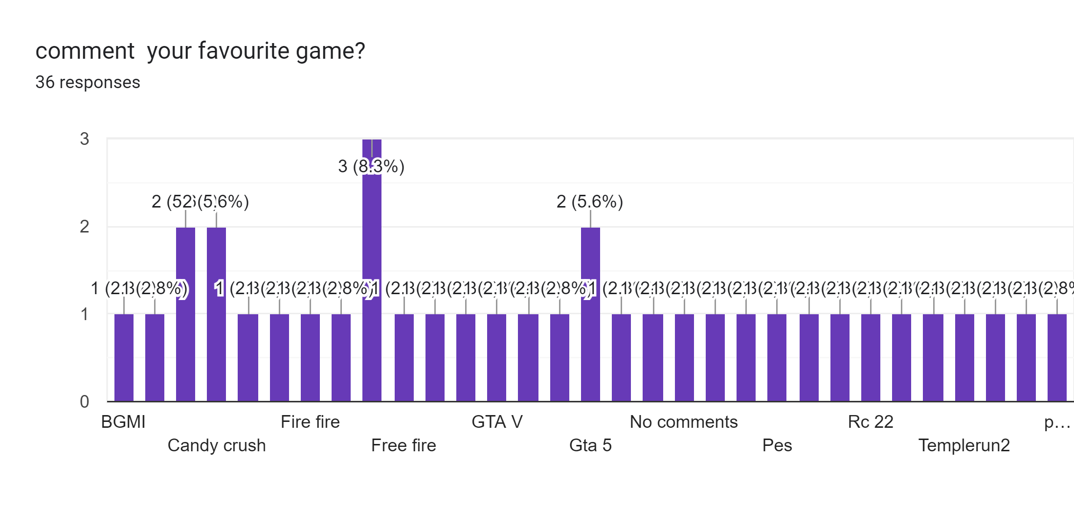
Most Favorite Games :

Slide 17
Future Enchancement:
1.Age and gender dominance is likely to improve in the near future. Online gaming will soon see a shift in the age and gender composition of the total population since the huge untapped market is likely to experience this world of gaming
Cloud gaming is going to get very popular especially in India. All people would need to have is a stable internet connection and they could get an experience of gaming like never before.
Freemium companies will help the industry to get better economic conditions. We are a very price-sensitive market and freemium gamers would continue to search for alternatives if the companies start charging for premium services.

Slide 18
Conclusion:
The present study focused on the high school students that use their own personal computer for playing online games and develop game addiction. As related with the findings, we are aware of the effects of online game addiction on gender differences.
Having a large sample of students with different backgrounds may enable to generalize the results to the population. The further studies could be applied to other age groups such as secondary or university students in order to obtain a variety of views on the issue.
N addition, students having online gaming habits are suggested to develop awareness about troubles that come with addiction.

Slide 19
References:
Chou, C., Condron , L. & J., C. (2005). A review of the research on Internet addiction. Educational Psychology Review, 17(4), 363-388.
Hyun, G., J, Han, D., H., Lee, Y., S., Kang K., D., S., K., Chung, U. & Renshaw, P., F. (2015). Risk factors associated with online game addiction: A hierarchical model. Computer in Human Behaviour, 48, 706713.
Journal of Management Engineering and Information Technology (JMEIT) Volume -4, Issue- 3, Jun. 2017, ISSN: 2394 - 8124 Impact Factor : 4.564 (2015) Website: www.jmeit.com | E-mail: editorjmeit@outlook.com|jmeit@outlook.com
Holland Kim, J., K. & Kim, Y. (2013). Self-traits and motivations as antecedents of digital media flow and addiction: The internet, mobile phone and video games. Computer in Human Behaviour, 29, 2416-2424.
Tone, H., Zhao, H. & Yan, W. (2014). The attraction of online games: An important factor for Internet addiction. Computer in Human Behaviour, 30, 321-327.
Wan, C., S. W., B. (2006). Why are adolescents addicted to online gaming? A interview study in Taiwan. hyper Psychology & Behaviour, 9(6), 762-766.

Slide 20


